Slide 1
Strain Theory

Slide 2
Classic Strain Theory (Merton, 1938): Basic Argument…
Offered a description of what kinds of values modern American society privileges, i.e. what constitutes “success”
Analysed the extent to which people (from different socio/economic groups) were able to pursue, access and achieve that success legitimately.
Those who were unable to do so experienced STRAIN – a disconnect between desires/aspirations (on the one hand) and the means to achieve them (on the other).
By way of response, a number of coping strategies are employed, one of which may be CRIME.

Slide 3
The American Dream
Our cultural wallpaper……

Slide 4
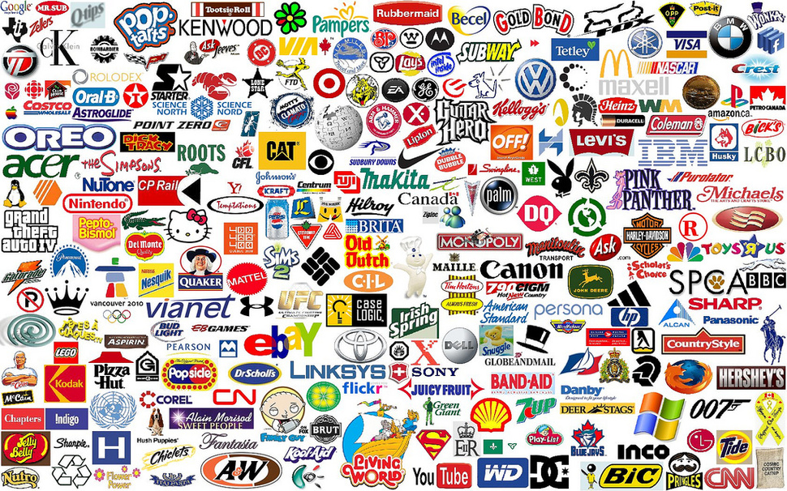

Slide 5

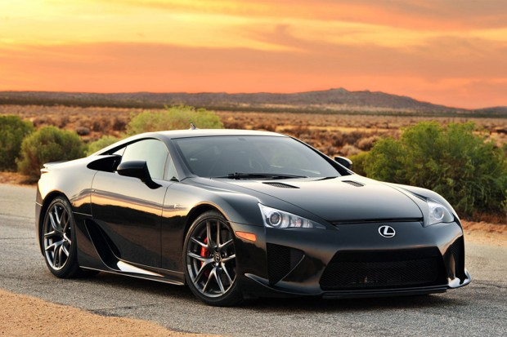
What our houses & cars “should” look like….

Slide 6

What our weddings “should” look like….

Slide 7
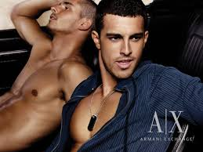

What we “should” look like….

Slide 8


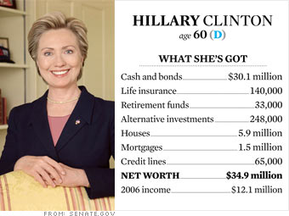

Who are leaders and icons are…

Slide 9
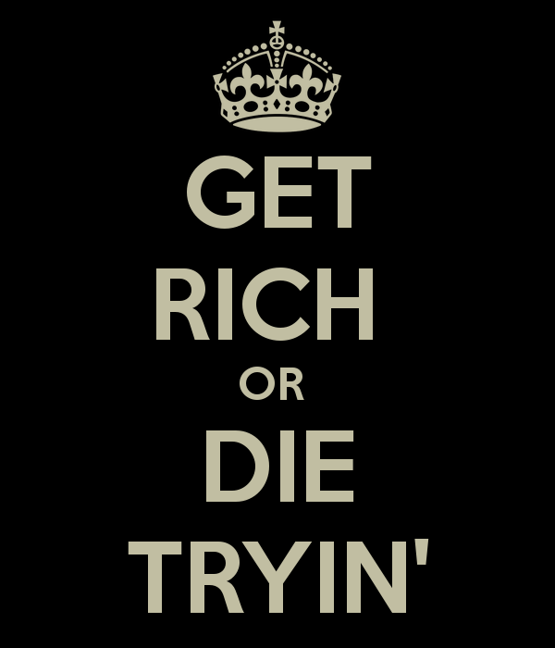

The aim of the game…

Slide 10
Cultural Messages…
GOALS
MEANS
Money
Material goods
Social status
Hard work
Education
Steady employment

Slide 11
Understanding Strain…
Culturally accepted goals:
Accumulation of wealth
Culturally accepted means:
Middle class values: hard work, honesty, deferred gratification, education
Not everyone equally able to reach goals
…. so importance of means as goal in itself
BUT: if goal over-emphasised at expense of means…
… and people can’t achieve it…
… results in strain
Strain is concentrated among people in lower socio-economic groups
… who are constrained by social structure

Slide 12
Cont’d…
Strain arises when…
Culture places disproportionate emphasis on goal (of wealth) over means (hard work)
Maintains it is available equally to all
BUT social structure restricts possibilities of achieving it through cultural means (hard work)
Contradiction between culture and social structure = ANOMIE

Slide 13
Anomie: Durkheim
1) Division of Labour in Society (1893)
  Anomie as feature of change to modern industrial society
2) Suicide (1897)
  Anomie as individual social psychological adaptation

Slide 14
Division of Labour in Society (1893)
Process of social change
  Mechanical society (self-sufficient, no division of labour, uniformity of consciousness)
  Organic society (highly organised, complex division of labour)
Laws maintain social solidarity in both
During change anomie can occur

Slide 15
Merton’s Difference from Durkheim
  NOT restrained by social rules (but encouraged by social rules)
  NOT lack of social rules/normlessness (but inability to achieve according to rules)
  NOT about innate desires (but cultural desires)

Slide 16
The American Dream & Merton’s Strain Theory
Institutional means – lawful methods of achieving goal (hard work)
Not all can achieve it, but the means themselves are inherently good
Problem: when there is too much emphasis on goals rather than means
Culturally defined way of life can bring no reward = strain
Anomie: disjuncture between cultural norms & goals & social structured capacities

Slide 17
Coping Strategies…
CONFORMITY
INNOVATION
RTTUALISM
RETREATISM
REBELLION

Slide 18
Conformity: Accept cultural goals and institutional means of achievement
Innovation: Accept the goals, but reject the means
  - Leads to crime and deviance as ANY means of achieving goal is deemed legitimate
  Often within poorer sections of society, trying to achieve wealth
Ritualism: Reject the goals but accept the means
  - ‘...the perspective of the frightened employee, the zealously conformist bureaucrat’ (Merton, 1957, 150)
  - Never successful, never in trouble
  - Lack of commitment to goals or acceptance of inability to achieve

Slide 19
Retreatism – rejects goals and means
  - Effectively ‘opts out’ of society
  - Hippies, vagrants, ‘winos’ etc
Rebellion – rejects goals and means
  - BUT replaces them with new ones
  - Revolutionaries, socialists, terrorists

Slide 20
 | GOALS | MEANS
CONFORMITY | YES | YES
INNOVATION | YES | NO
RITUALISM | NO | YES
RETREATISM | NO | NO
REBELLION | REPLACE | REPLACE

Slide 21
Historical Context.
What was happening in 1930s America?

Slide 22
The Great Depression
Stock market crash October 29th 1929
25% unemployment in the US
Construction halted
Farming and rural communities saw their revenues plummet
Foreign trade fell by 50%
Mass poverty
BUT: American Dream still propagated as attainable

Slide 23
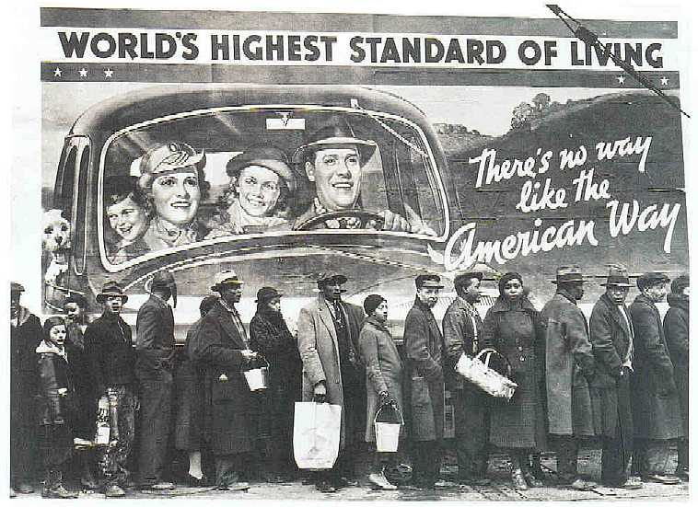
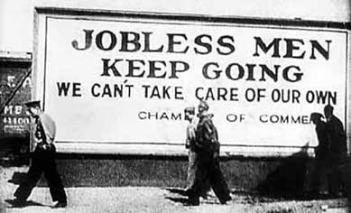

Slide 24
Strengths and Implications
Shows how social, cultural and economic circumstances can create pressures that encourage crime
Casts deviance as a defining feature of capitalist societies: desire to consume regardless of possibilities (Downes and Rock 2007)

Slide 25
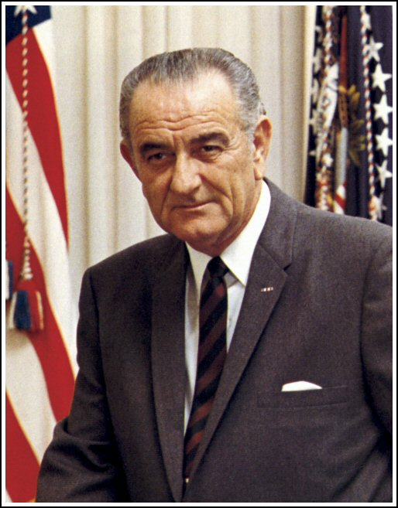
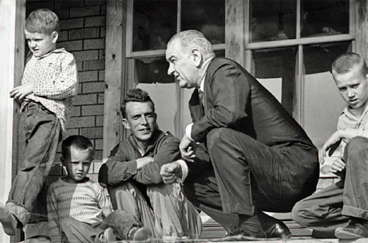
Policy Implications
1964: Lyndon Johnson’s “War on Poverty”
  Work training programmes for those too poor to complete education
  ‘National Job Corps’
  Community action programmes
  Employment incentives
  Established food stamps, work study, Medicare and Medicaid

Slide 26
Limitations
Over-predictive?
Why do some people innovate and others do not?
How to explain women’s lesser involvement in crime?
Ignores crimes of the powerful?
Are cultural goals really about wealth?
Can we really talk about consensus of cultural goals?
Other barriers to achievement? (gender, ethnicity, intelligence…?)

Slide 27
Adapting Strain Theory: Delinquent Gangs
Cohen 1955: Youths blocked from middle class adult goals (e.g. educational success)
Cloward and Ohlin 1960: Youths blocked from wealth
  Form delinquent gangs to create ways of making money
Concept of ‘status frustration’ rather than anomie
Cultural goals could now be attained within the gang (subculture’s own value system in which success could be achieved)
Anger, frustration, shame

Slide 28
General Strain Theory (Agnew, 1991)
Beyond Mertonian strain & status frustration to other sources of criminogenic strain
Strain = inability to achieve desired goal
  Removal of positively valued stimuli
  Presentation of negative stimuli

Slide 29
Types of Strain most likely to lead to crime (Agnew, 2002)
Strain seen as unjust
Strain of high magnitude (depth & frequency)
Strain caused by or associated with low social control
Strain creates emotional pressure to engage in criminal behaviour. ‘Criminal coping’.
Why do some people get angry and not others?
  - Support systems
  - Personal resources (emotional/psychological)
  - Past experiences (generational, community-based disenfranchisement)

Slide 30
Moving on from Merton…
Strain not concentrated in lower socio-economic groups... but across society
Not deterministic but introduces ideas of human agency
Explains why some offend and not others
Explains why some choose deviant adaptations and not others
Connections between stressful life events and delinquency – supported by research

Slide 31
Strain: Crime Etiologies…
Crime as a result of normlessness
Crime as an adaptation to structural conditions
Crime as an emotional response to structural conditions
Crime as an emotional response to injustice

Slide 32
Next week…
Subcultural theories

